Slide 2
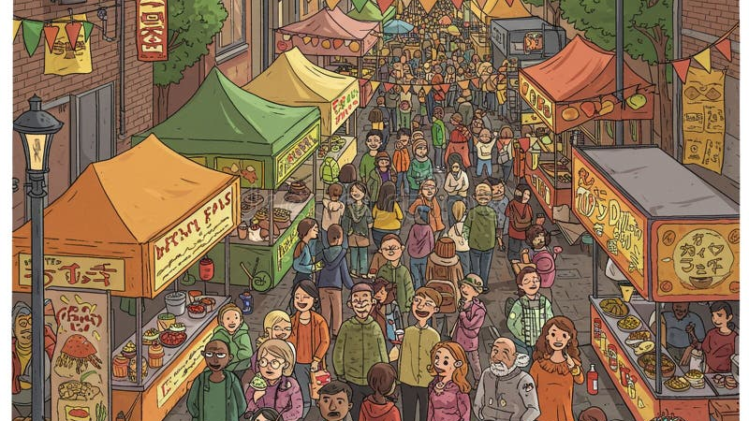

Slide 3
Retail is Simple, not Easy

Slide 5
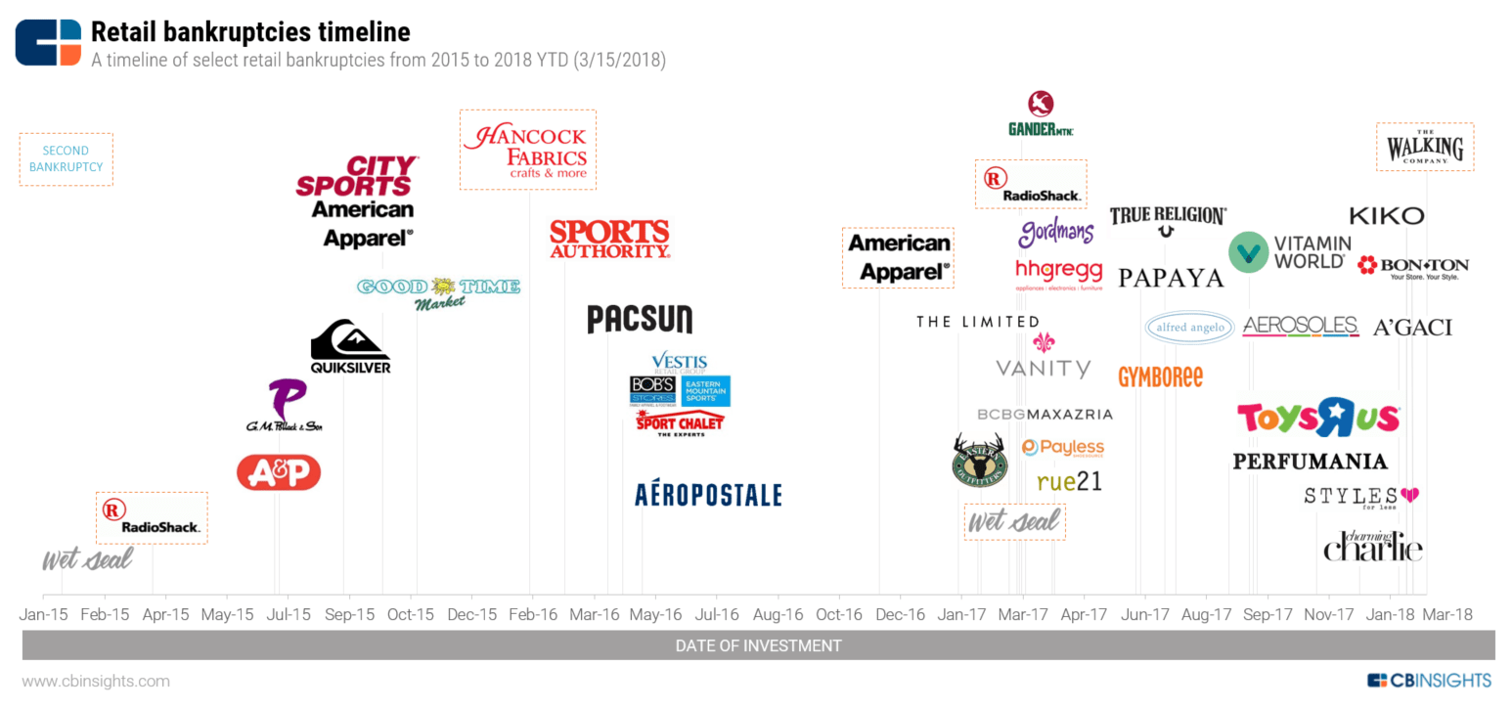

Slide 6
Retail is a war fought EVERYDAY

Slide 7
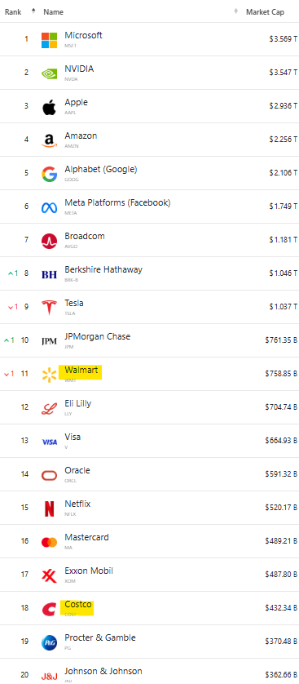
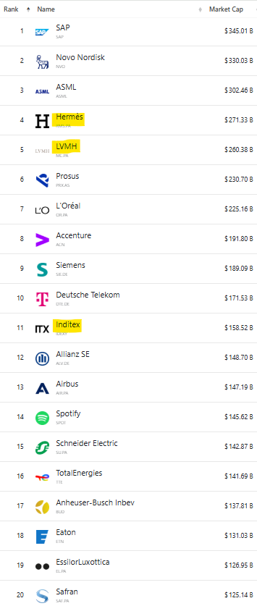
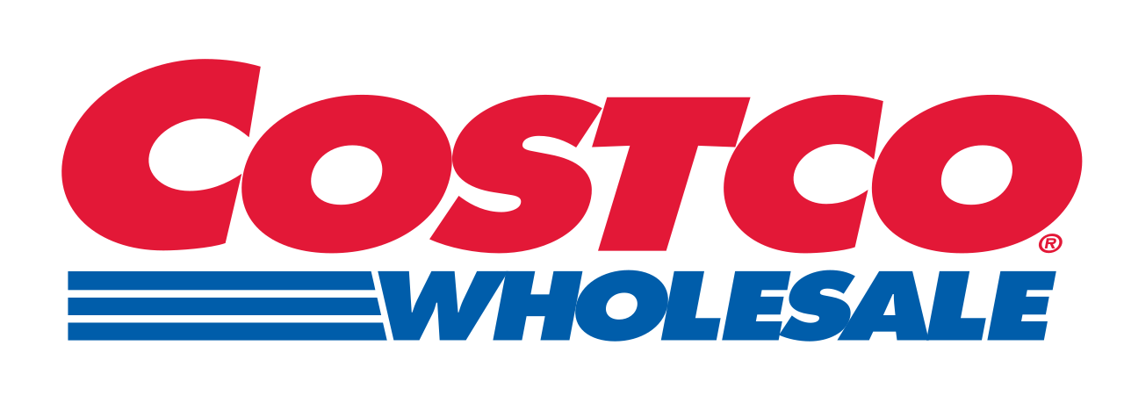
$271.33bn
$758.85bn
$260.38bn
$158.52bn
$432.34bn
Source: https://companiesmarketcap.com

Slide 8
Average Customer has a lower income than the national average for the US
Average Customer has a higher income than the national average for the US

Slide 10
Source: Annual Reports (FY24)

Slide 11
Source: Company Disclosures

Slide 13
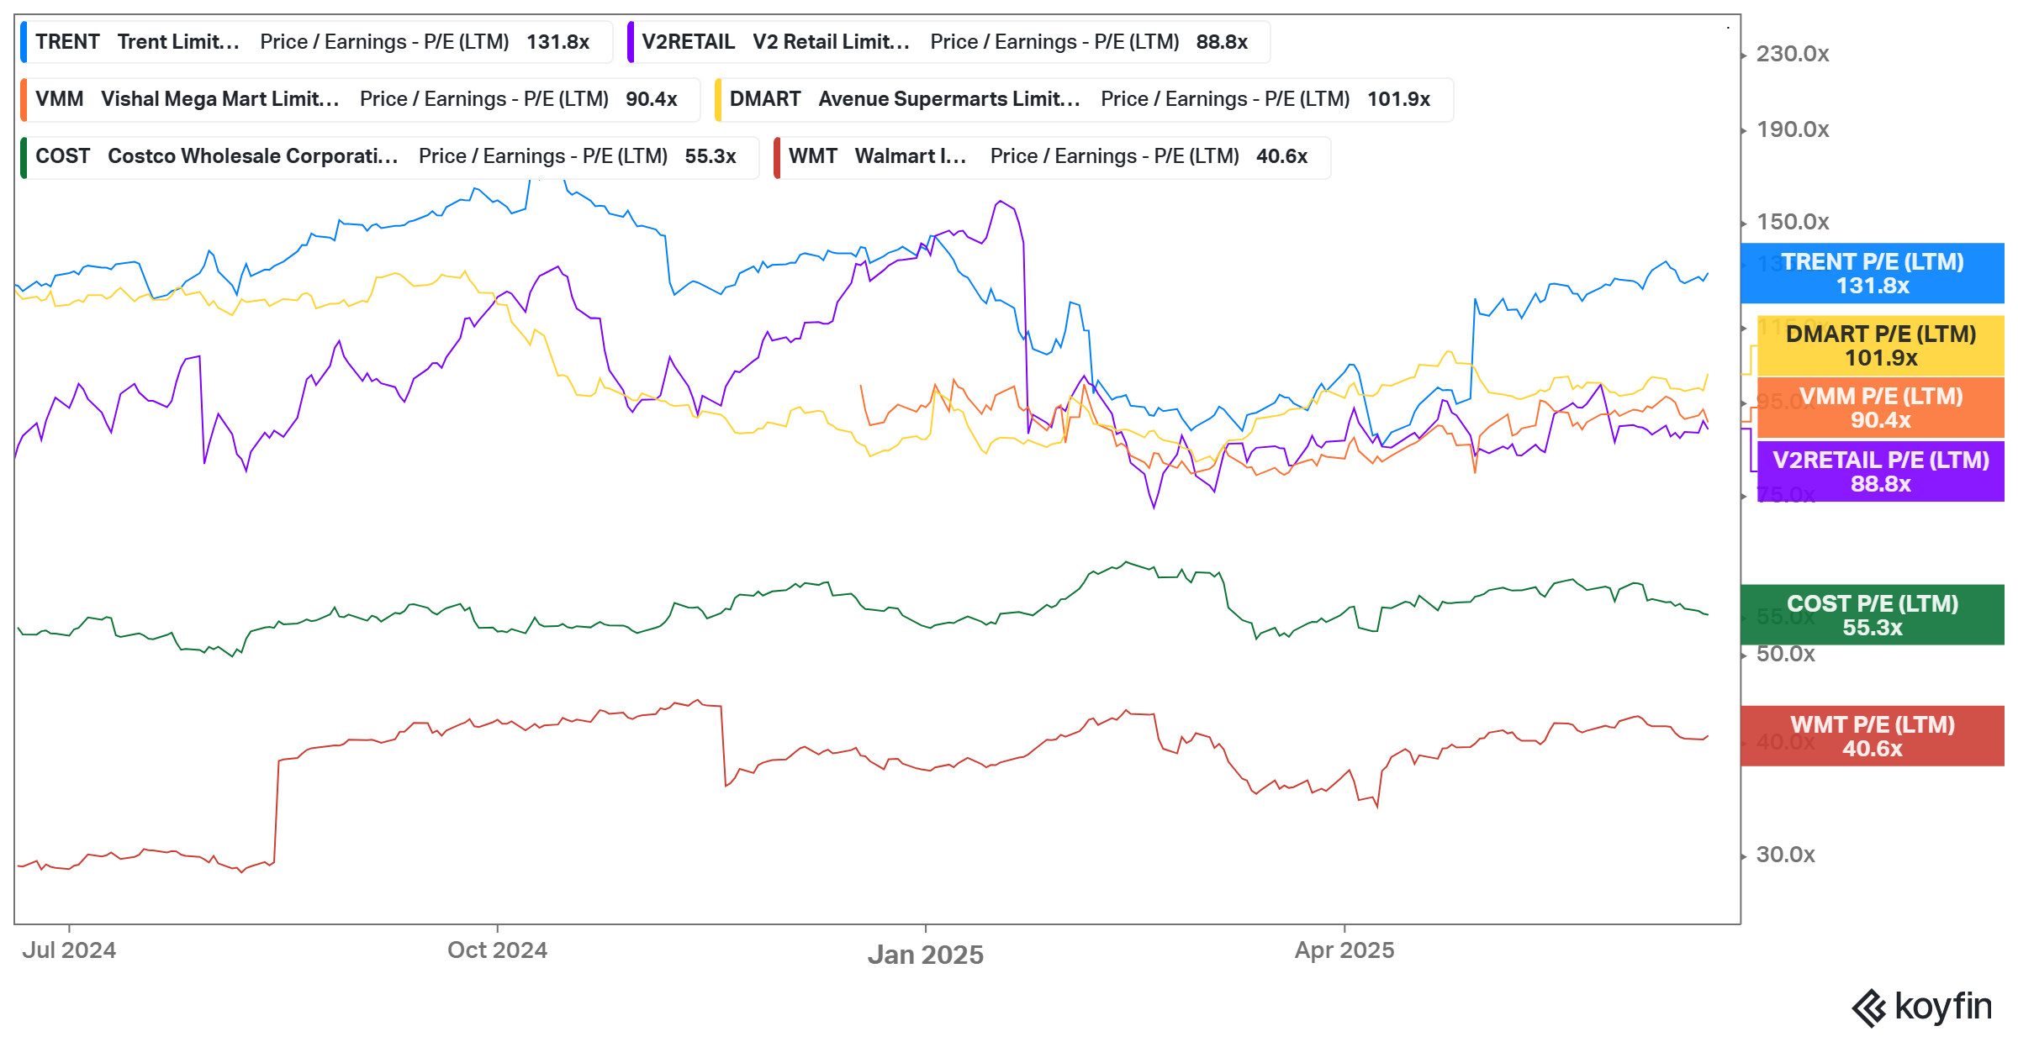
Source: KoyFin

Slide 14
The India Consumption Story

Slide 15
Source: ABFRL Investor Day Presentation

Slide 17
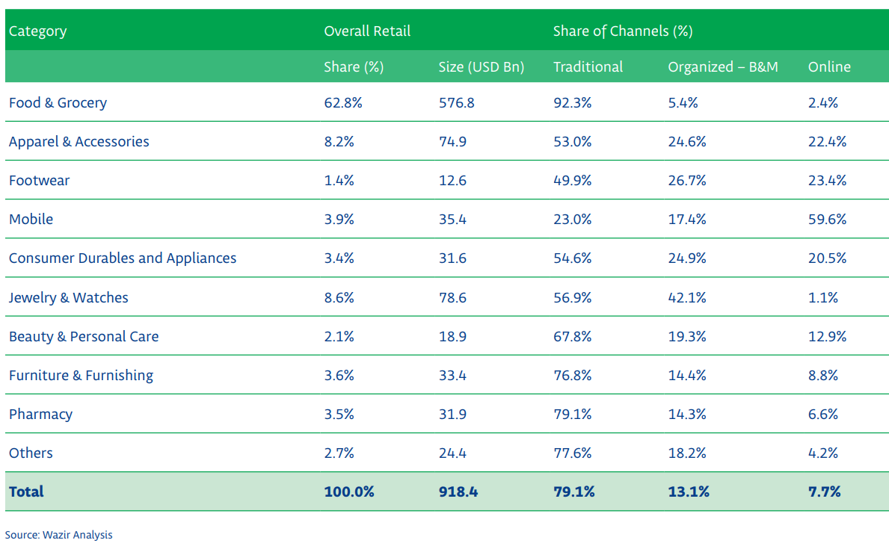
Source: Wazir Analysis (FY23)
Notes:
341 – no F&G

Slide 18
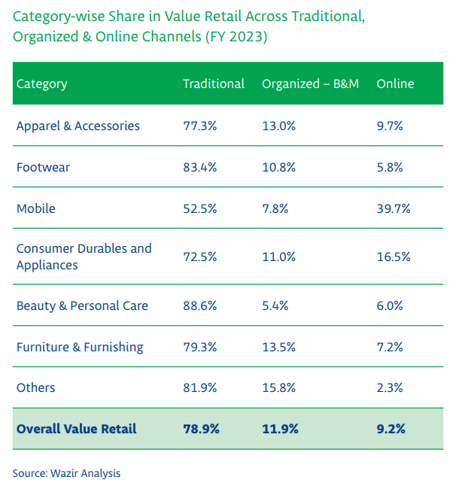
Notes:
$111.6Bn

Slide 19
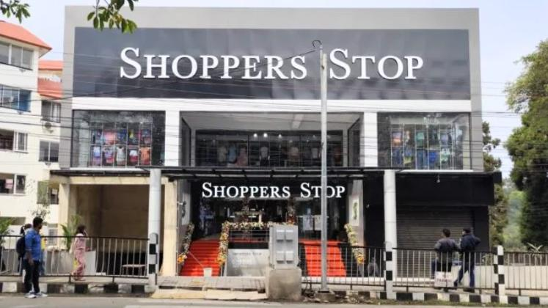
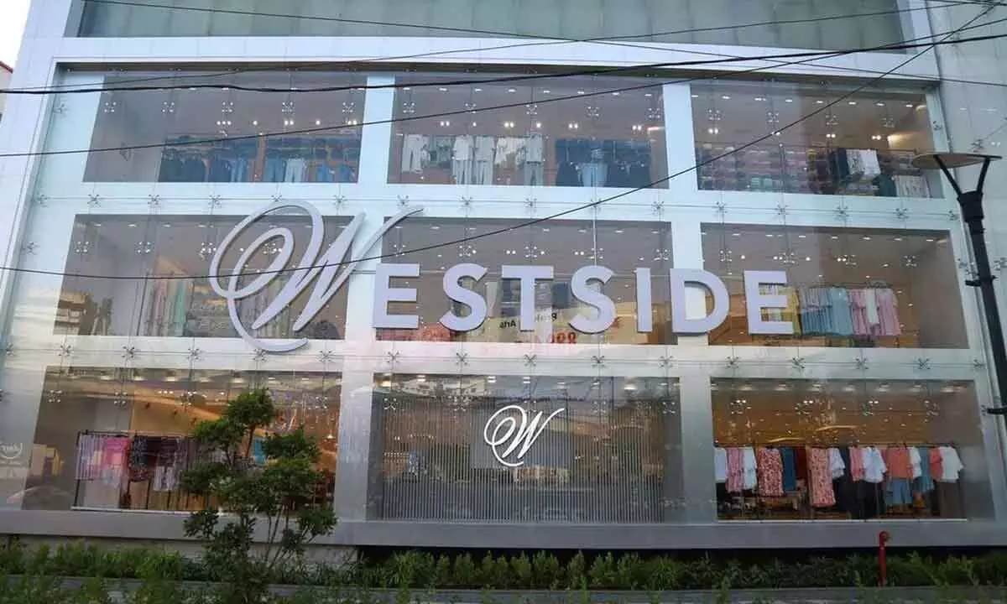
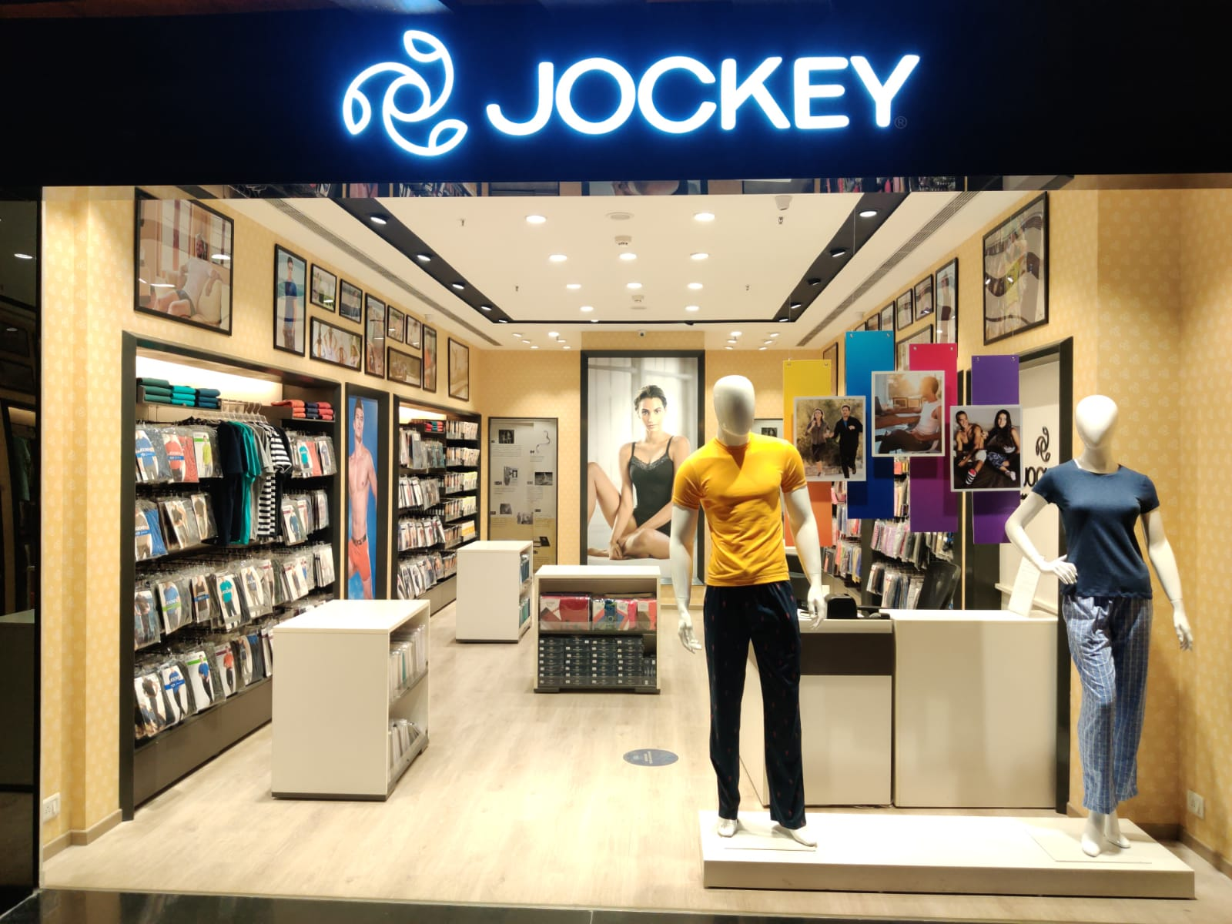
Multi-Brand Outlets (MBOs)
Large Format Stores (LFS)
Exclusive Brand Outlets (EBOs)
Notes:
Multi-Brand Outlets (MBOs):

Slide 20
Retail Challenges

Slide 21
Source: Vector Consulting

Slide 22
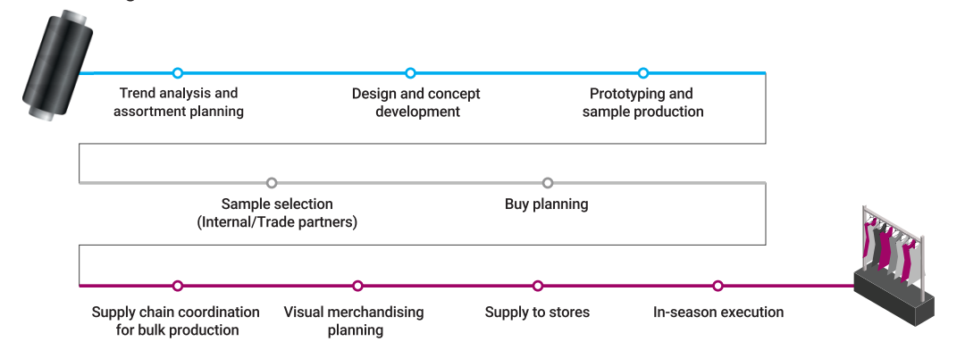
Steps in delivering a fashion season for a retail brand
Source: Vector Consulting
Notes:
Internal and external collaboration is must!

Slide 23
Lead Time
Source: Vector Consulting, 100 respondents

Slide 24
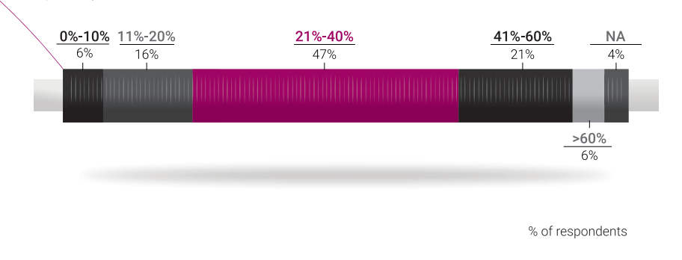
Percentage of styles which gets into broken size sets at store (with no stock at warehouse to replenish)
Wrong forecasts leading:
Some styles selling fast
Cut sizes
2. Some styles selling slower
Low sell through
Full-price sell-through percentage (without discount) for the season
Source: Vector Consulting, 100 respondents
Notes:
Long lead time also comes with higher set of variations

Slide 25
Percentage of actual receipts v/s the original deployment plan (at a style level) at stores
On-Time In-Full %
Average Delay in receipt at store vis-à-vis the planed date
Source: Vector Consulting, 100 respondents

Slide 26
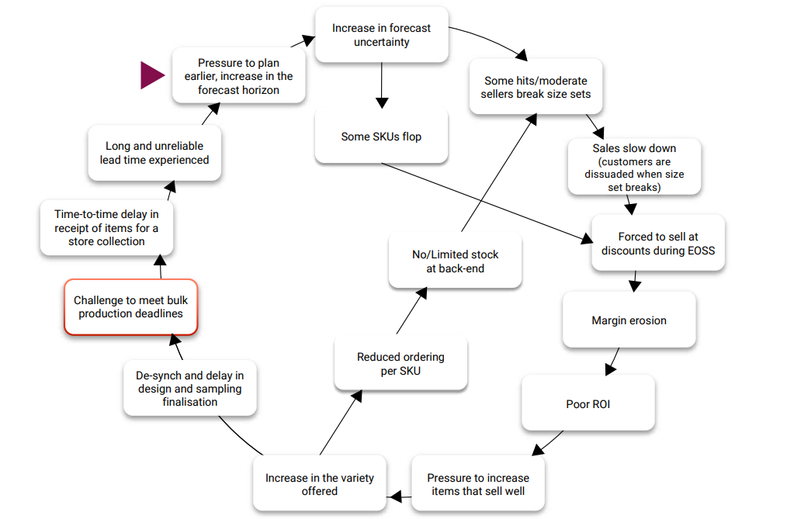
Source: Vector Consulting

Slide 27
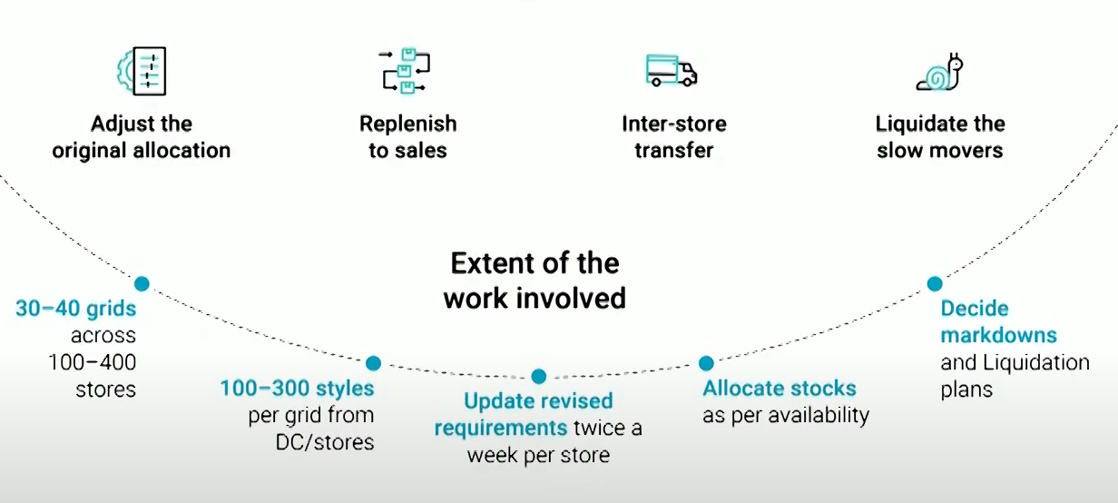
In season tactics to overcome the long lead time shortcomings
Source: Vector Consulting

Slide 28
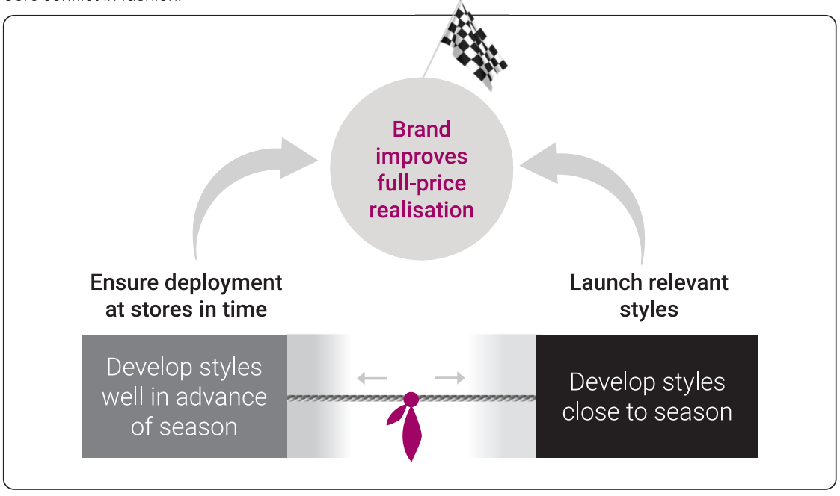
Core conflict in fashion
Source: Vector Consulting

Slide 29
Source: Company Disclosures

Slide 30
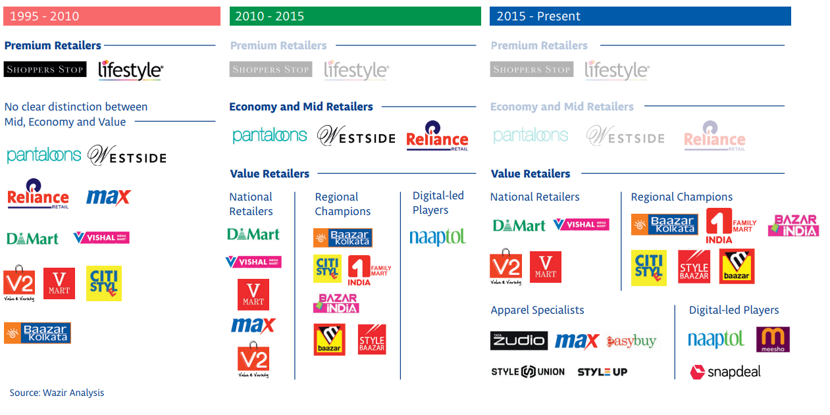

Slide 31
Value Retailers of India

Slide 32
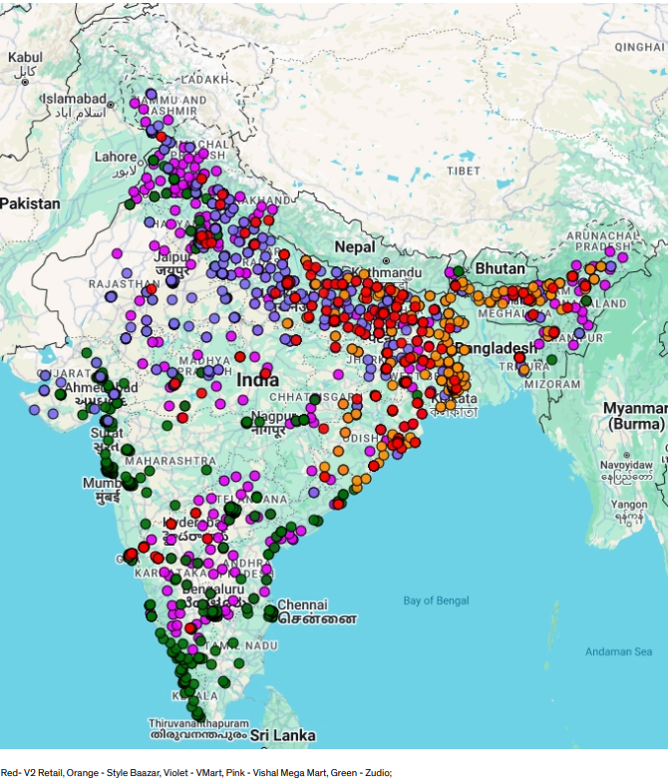
Value Retail Brands
~2000 Stores
Source: Company presentation (Q4FY25)
Notes:
Strategies:
Optimal store design and layout
Real estate strategy
Cluster based expansion
Lean staffing models: with manpower costs accounting for approximately 4% of revenue, compared to about 10% at upscale retailers
Supply chain management
Private labels

Slide 33
Strategies of Value Retailers

Slide 35
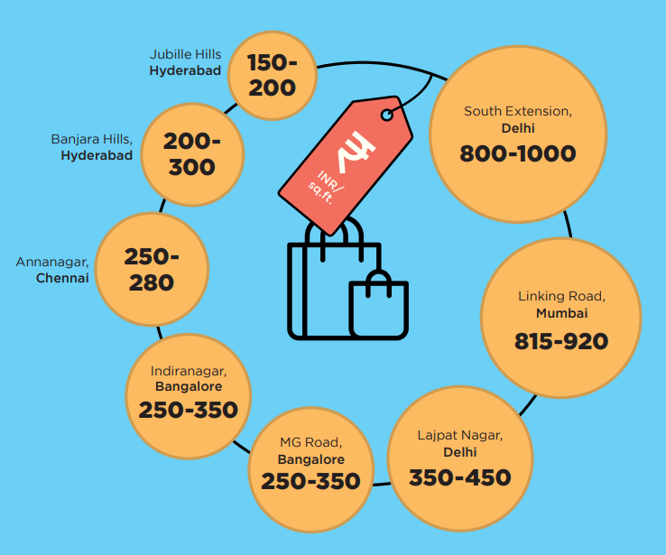
Source: Anarock

Slide 36
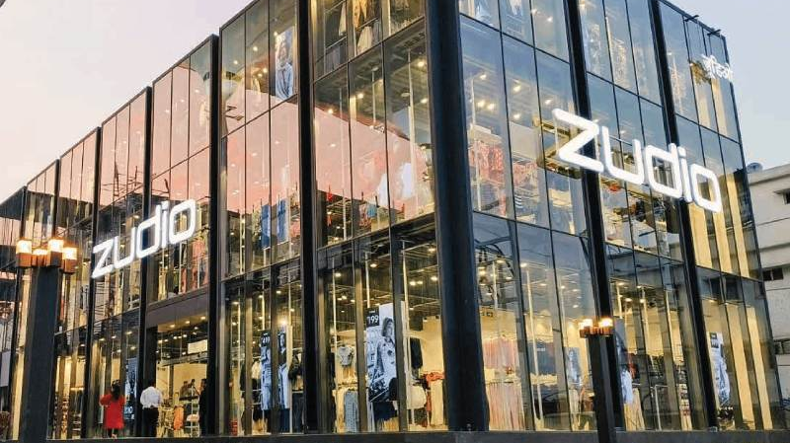

Slide 37
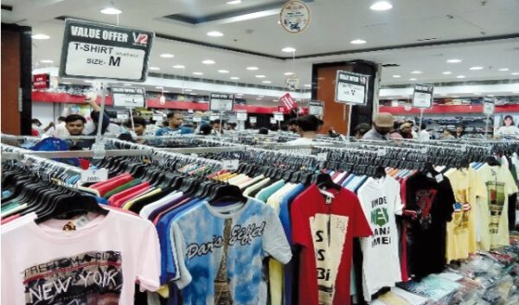

Slide 38
Source: Dmart Investor Presentation

Slide 39
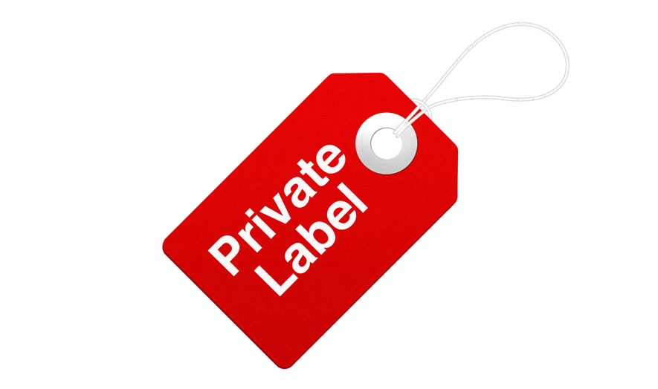

Slide 40
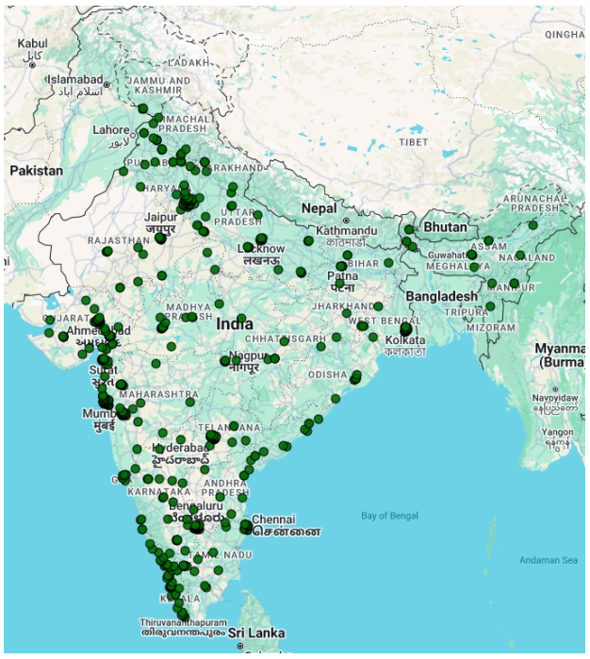
Zudio 765 Stores | 235 Cities
Source: Company presentation (Q4FY25)

Slide 41
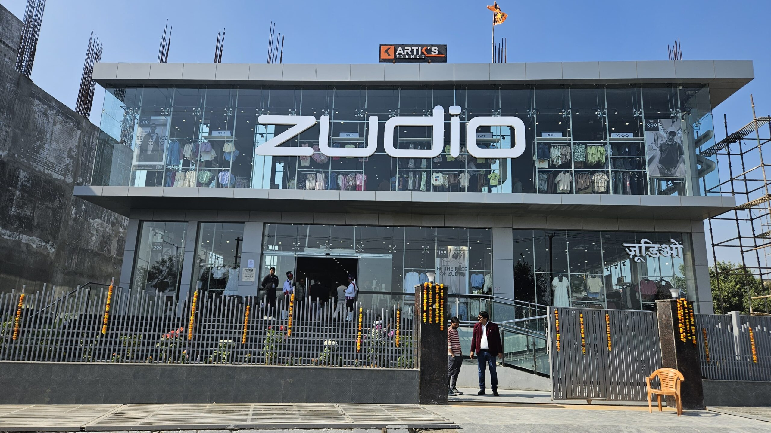
Average store size – 7,000-12,000 sq ft
Average Capex Cost – 3-4cr
Notes:
Strategies:
No seasonal inventory – new inventory every 2 weeks
FOCO model

Slide 42
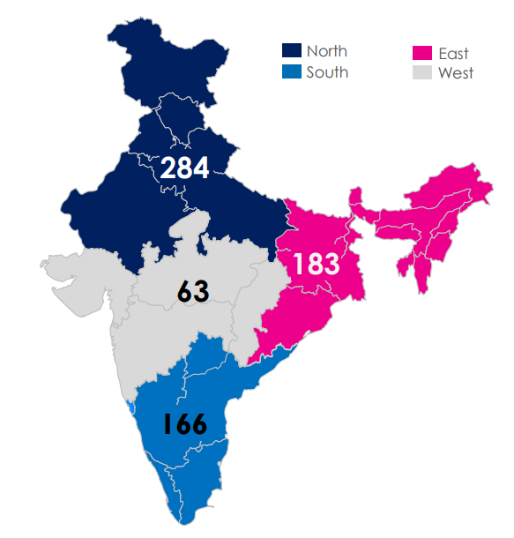
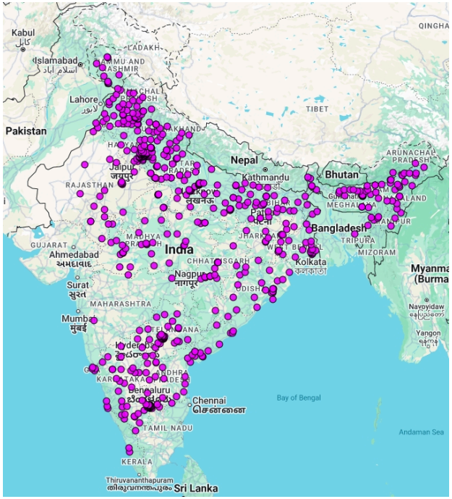
Vishal Mega Mart
696 Stores | 458 Cities
Source: Company presentation (Q4FY25)

Slide 43
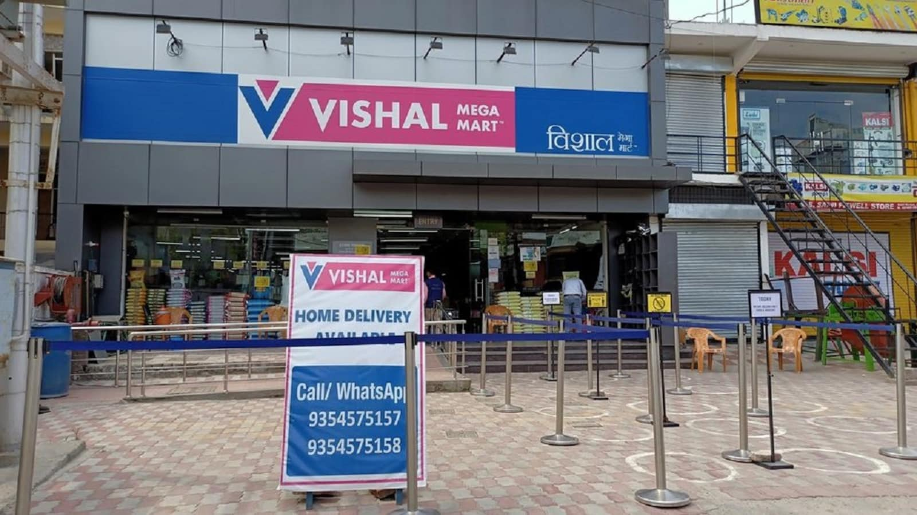
FMCG(28%) + GM(28%) + Apparel (44%)
Private label: 73%
Average store size: 18,000 sq ft
Notes:
Strategies:
FMCG gets volume and apparel get margins
They store bulk of the inventory at regional warehouses, and then do milk run to stores every morning. The cost to store inventory at warehouse (Rs. 10/ sq ft) is much lower than at store (Rs. 60/sq ft)

Slide 44
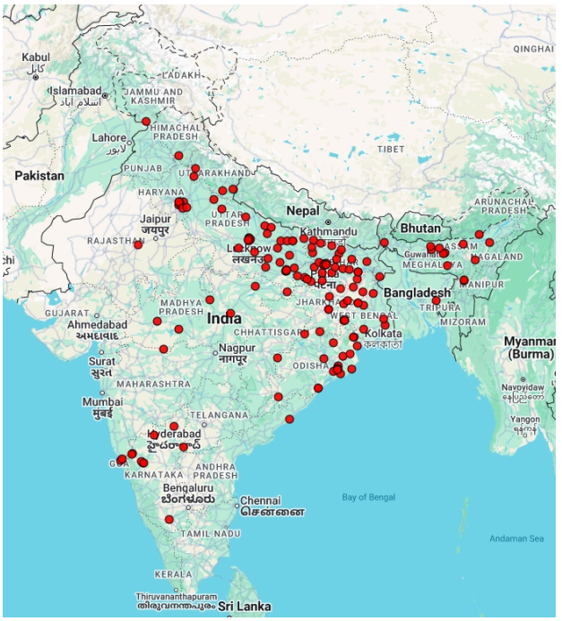
V2 Retail 189 Stores | 150 Cities
Expansion plan: ~100 stores
Source: Company presentation, con calls (Q4FY25)
Notes:
Strategies: Focus on higher Inventory Turns at the cost of margins to free up working capital and maintain freshness in stores
Discounts:
Identify slow movers
2 weeks – 30% discount
1 month – 50% discount
2 Months – 70% discount
40% - own Design

Slide 45
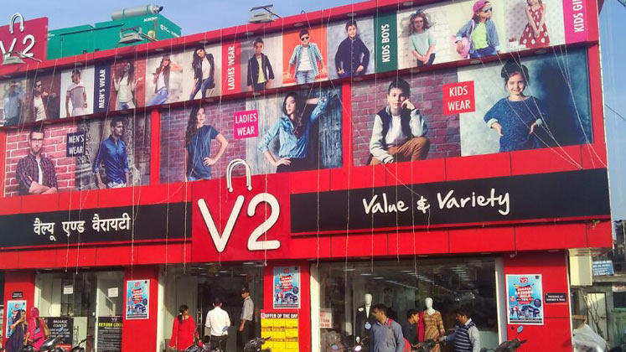
Private label – 85%
Capex – 2.2cr

Slide 46
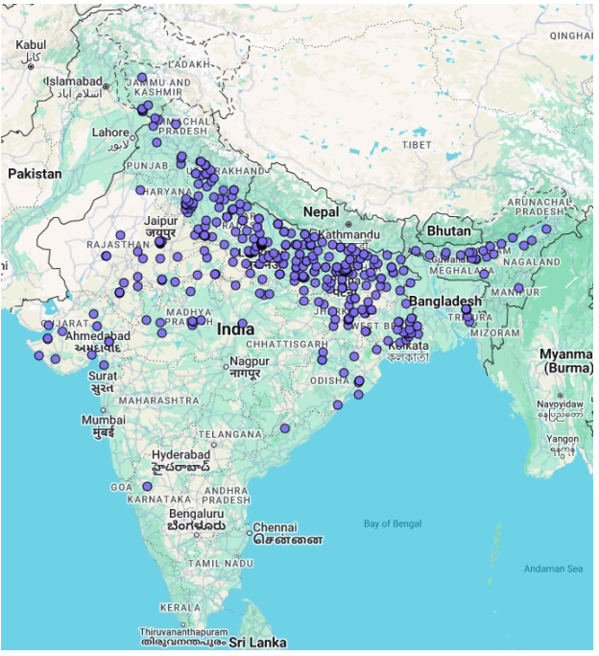
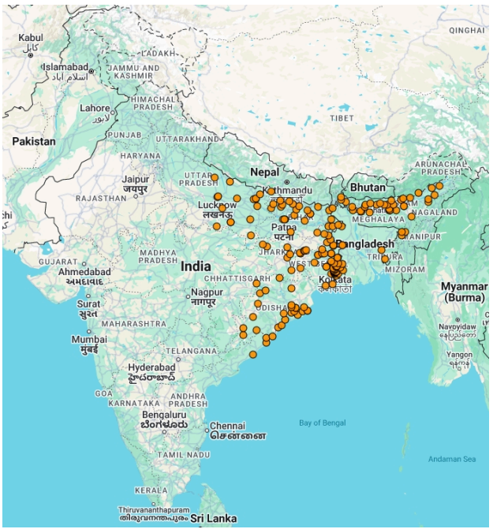
Vmart 412 Stores | ~315 Cities
Style Baazar
214 Stores | 174 Cities
Excluding Unlimited (85 stores, mainly in south)
~65 stores
Expansion Plan: ~40-50 stores
Source: Company presentation , con call(Q4FY25)

Slide 47
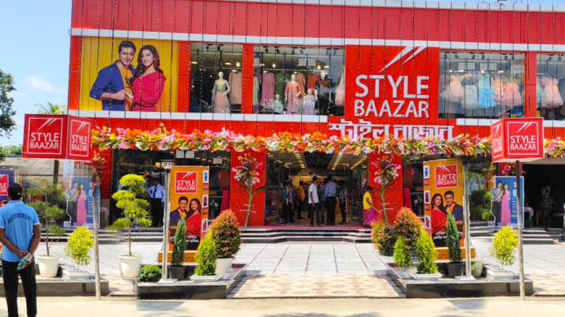

Slide 48
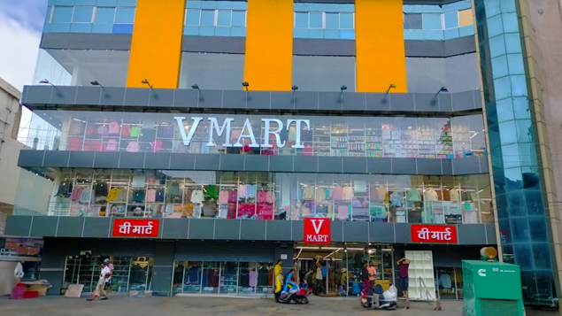

Slide 49
Parent Company/ Promoters | Trent (Tata Group) | Reliance | Biyanis | ABFRL | Shoppers Stop
Month/Year of Start | Sep'16 | Aug'23 | 2022 | 2023 | Jun'23
No of Stores | 765 | 84 | 118 | 46 | 71
Expansion plan | ~150-200 | 1000+ stores by 2026 | ~60-70 | ~40-50 | ~40-60
Source: Company disclosures, con calls

Slide 50
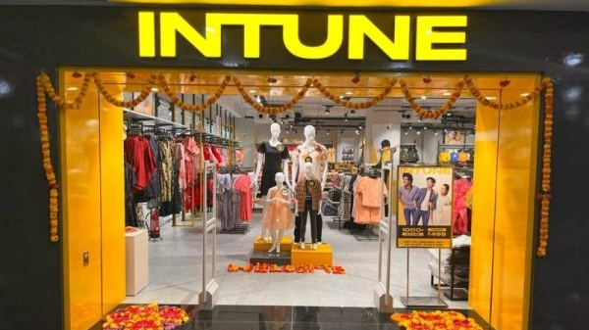
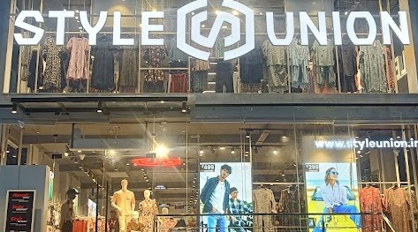
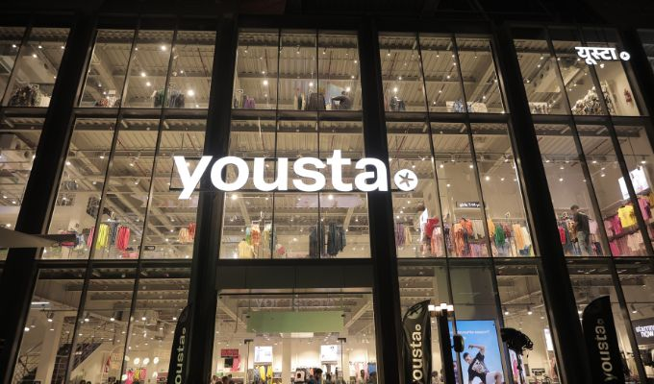
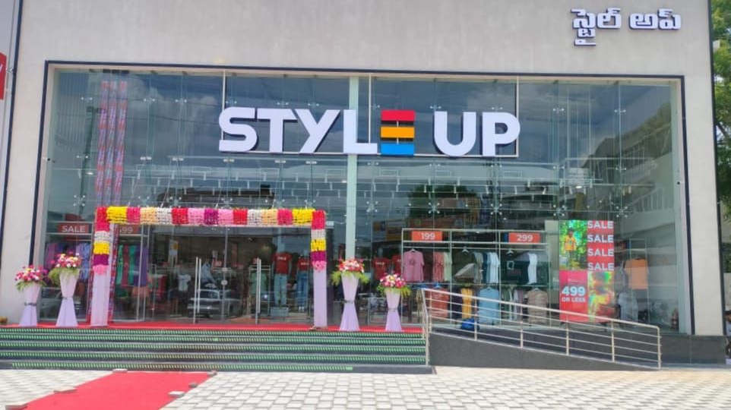

Slide 51
Source: Company Disclosures

Slide 52
Source: Company Disclosures
* 3-year CAGR

Slide 53
Source: Company Disclosures
# Calculated
*3-year CAGR

Slide 54
Source: Company Disclosures
Notes:
Trent – apparel has had double digit sssg

Slide 55
*
*
*Calculated
#FY24
Source: Company Disclosures

Slide 56
Source: Company Disclosures

Slide 57
Source: Company Disclosures
*FY24

Slide 58
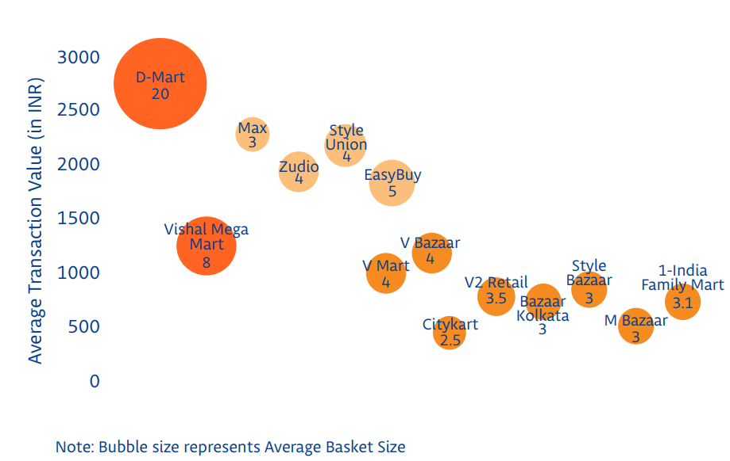
Average transaction value and basket size
Source: Wazir Analysis

Slide 59
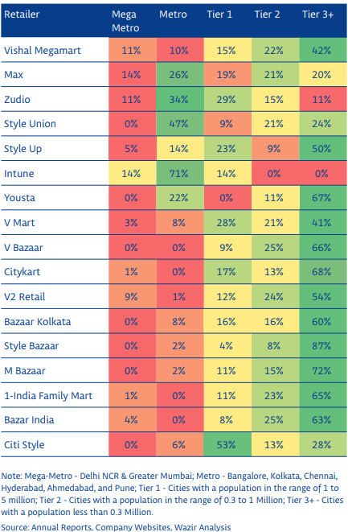
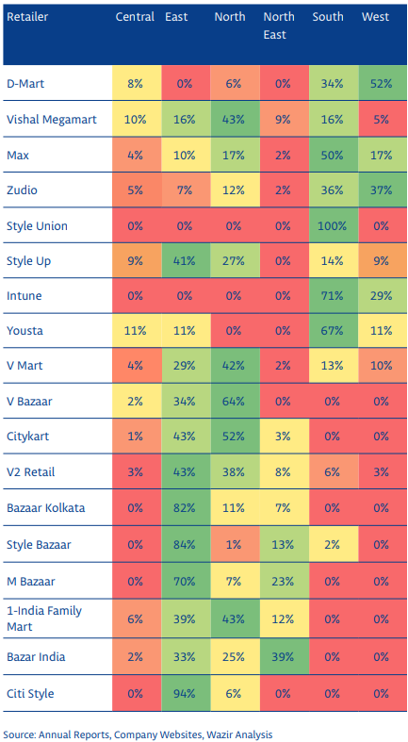

Slide 60
Source: Company Disclosures

Slide 61
Source: Company Disclosures

Slide 62
Source: Company Disclosures

Slide 63
Source: Company Disclosures

Slide 64
Source: Company Disclosures

Slide 65
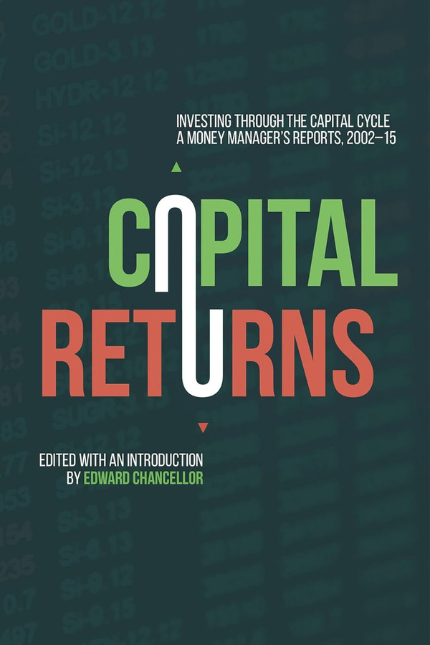
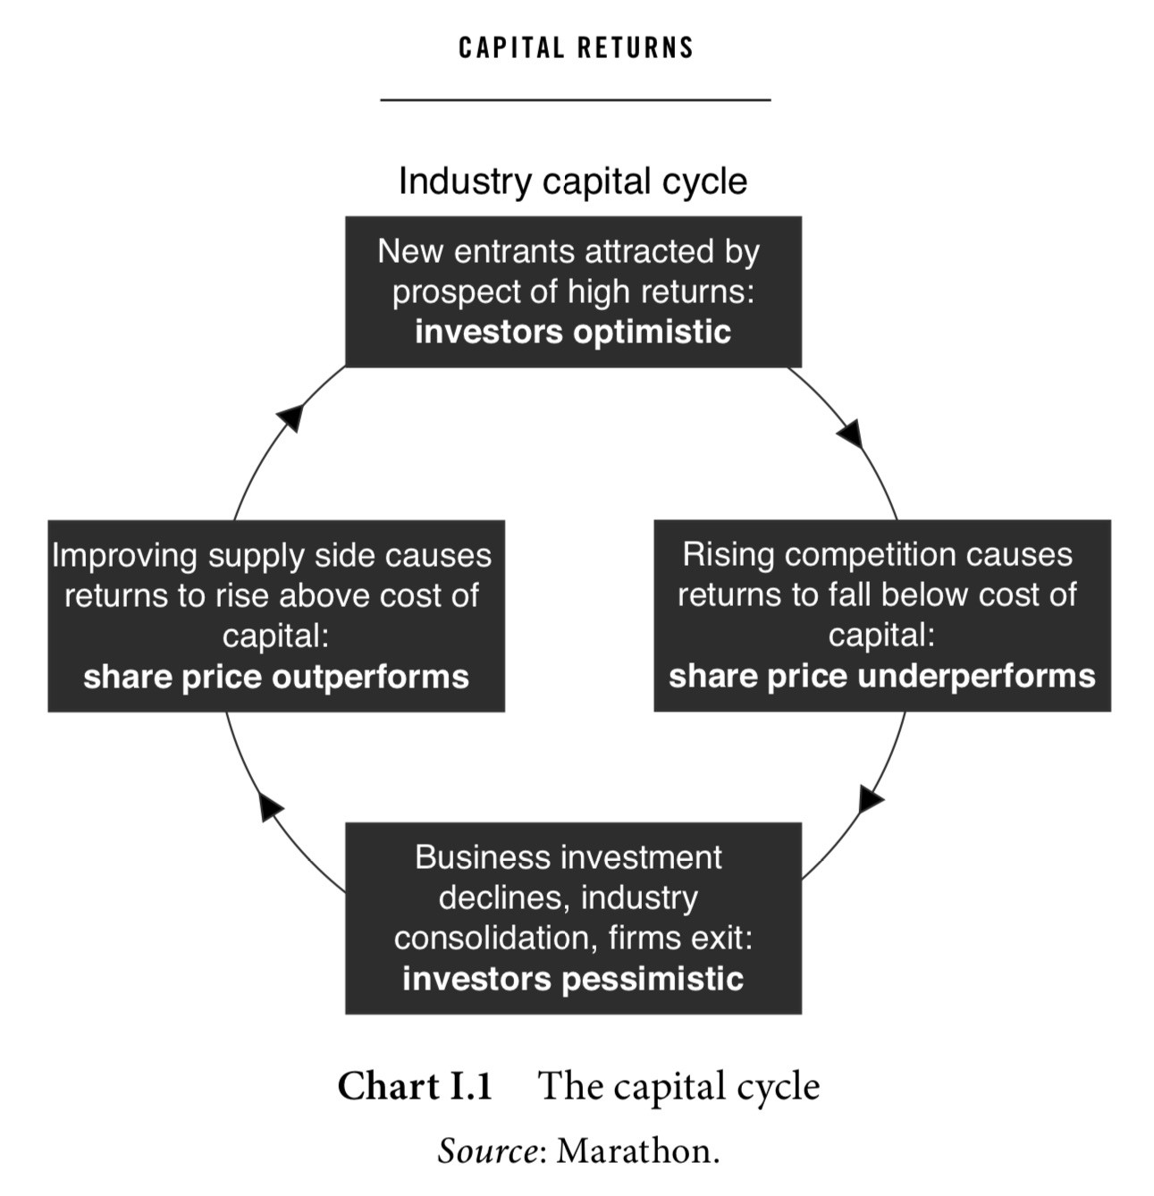

Slide 66
Questions??

