Slide 1
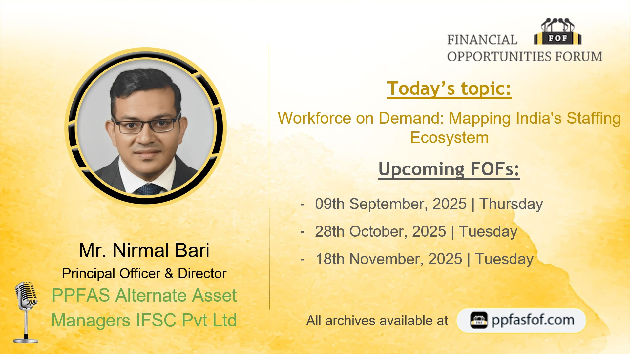

Slide 2
Workforce on Demand: Mapping India’s Staffing Ecosystem
Notes:
Staffing industry has become omnipresent in today’s economy. We would be utilizing its services on a daily basis without realizing it. E.g,
Dmart
Amazon
Mall or Airport
People selling credit cards
Workers engaged in infrastructure & construction
More likely than not that these workers would be employed by a staffing company
Define – Permanent Staffing, Temp Staffing/Contractual Staffing, Gig Workers

Slide 3
Why Staffing?
Supports Business Agility
Employment Generator
Facilitates Employment Formalization
Bridges Skill Gaps
Notes:
Supports business agility – enables companies to scale up/down quickly, while reducing HR compliance burden
Employment generator – especially for youth and first-time job seekers
Facilitates formalization – brings workers under EPFO, ESIC etc
Fills skill gaps – through recruitment, training, and deployment

Slide 4
Staffing Industry – Opportunities in India
Demographic Dividend
Economic Growth & Urbanization
Shift from Informal to Formal Employment
Low Staffing Penetration
Emerging Hybrid, Remote, Flexi and Gig Work Models
Notes:
Demographic dividend - World’s second largest and youngest workforce
Economic Growth & Urbanization – Rising demand for both semi-skilled and skilled labour
Shift from Informal to Formal Employment
Low staffing penetration - at ~1% of the workforce in India vs >3% globally
Emerging trends of hybrid, remote, flexi and gig work models.
Let's look at some numbers to better understand the demographic dividend and shift to formal employment opportunity.

Slide 5
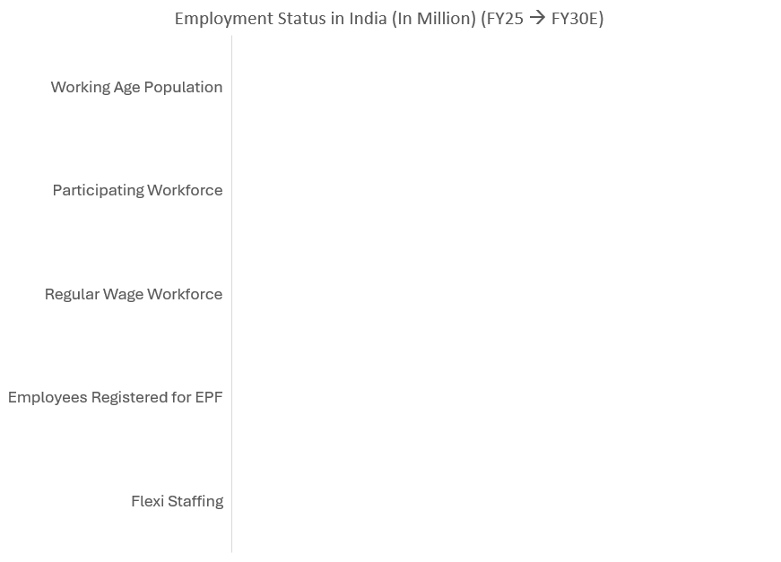
Status of Employment
900 → 1282
500 → 785
110
77 → 257
6 → 20
Source: EPFO, PLFS Annual Report, FY30 data from Quess Presentation of March 2022
Notes:
When we talk of formal employment, it is this EPO registered workforce.
Growth driver for Flexi Staffing is multifold – growth in formal employment + increased penetration

Slide 6
Government Policies & Support
Formal Employment Generation
Tax Benefit under Section 80JJAA
Implementation of new Labour Codes
Employment Linked Incentive Schemes – Outlay of INR 99,446 Cr over 2 years aiming to benefit 3.5 crore employees including 1.92 Cr first time EPFO entrants
Bridging the Skilling Gap
  National Apprenticeship Training Scheme
  National Apprenticeship Promotion Scheme
  Pradhan Mantri Kaushal Vikas Yojna
  Enforcement of Apprenticeship Act
  Craftsmen Training Scheme
  NEEM (Ended in 2022)
Notes:
Employment generation is a very important point for any govt and Indian govt has also come out with various policies on the same.
Additional Employee Cost means there should be net addition of employees, employee should be registered and contributing to EPF, new employee with first time EPF registration and less than 25000 salary
3 Schemes under Employment Linked Incentive Scheme – (a) DBT for first time employees registering on EPFO of INR 15000 in 3 tranches ; (b) Job Creation in Manufacturing; (c) Reimbursement to employers upto 3000 per month for 2 years.
NATS – 50% of stipend reimbursable by the government upto 4500. 1 year program
NAPS – 25% subsidy upto 1500 per month and upto 7500 basic training expense reimbursement

Slide 7
Does the clear necessity, macro tailwinds and govt support make for a compelling investment case?

Slide 8
Staffing Industry Categorization
Staffing Industry
Staff Augmentation
(Contractual Staffing)
Managed Services
Other HR Services (Search, RPO, Payroll, Compliance, Training, Job Portal etc)
General Staffing
Professional Staffing
(IT Staffing)
GCC as a Service
Facilities Management
Industrial Catering
Security Services
Business Services
Notes:
If we were to look at broadly what constitutes staffing, then at the very basic level we have staff augmentation or contractual staffing or flexi staffing. Revenues here are directly linked to headcount. Largest companies are Quess & Teamlease
If a company takes up additional KPIs as opposed to just providing the headcount and their revenues get linked to those KPIs, that would then be classified under Manager services – Managed Service companies – SIS, UDS, Bluesprings, Krystal etc
Other HR – No headcount, just service/software/ platform for the headcount –companies like Darwinbox, Naukri,

Slide 9


Easy to Enter, Difficult to Scale
What does it take to set up a staffing company?
What does it take to scale it up?
Company with PAN, TAN, GST registration
Provident Fund & other compliance
Contract Labour Act registration
Ability to comply with regulations in each state/district of operations
Continuous investment in technology
Recruitment capabilities
Strong brand name to attract and retain talent
Strong balance sheet to support working capital needs
No technical skills
No technology backbone
Minimal capital requirement
No brand name
Notes:
Continuous investment in technology backbone for Employee Lifecycle Management, Regtech, productivity improvement etc

Slide 10
Staffing Industry Characteristics
No barriers to entry
Crowded Industry
Commoditized Offering
Difficult to Scale
No pricing power
Notes:
Crowded Industry – As per some estimates there are 7000 staffing companies in India at present.
If you look at the two largest companies, they have a total of 7.5 lakh headcount of the total 60 lakh and there are only handful of companies which have been able to scale to even 1% of the industry size.
Companies which scale are then able to get some intangible benefits like visibility and ability to list.

Slide 11
General Staffing
Notes:
We will try to understand General staffing and Professional staffing business from the vantage point of the two largest companies – Quess & Teamlease

Slide 12
General Staffing – Headcount Growth
Industry headcount grew by ~15% and ~9% over past 10 years and 7 years respectively
 | Quess Corp | Teamlease
5 Year CAGR | 12.9% | 9.9%
Source: Company Presentation and Annual Reports, Industry Reports, PPFAS Research
Notes:
General Staffing Industry Headcount grew at 15% over last 10 years and ~10% over last 7 years. Current estimate ~60 lakh vs ~13 lakh in FY14 and 33 lakh in FY18. Teamlease general staffing excluding DA grew at 12.6% to 2.92 lakh
Define Associate vs Core Employees

Slide 13
General Staffing – Revenue Growth
 | Quess Corp | Teamlease
5 Year CAGR | 18.1% | 17.2%
Source: Company Presentation and Annual Reports, PPFAS Research
Notes:
Revenue growth is higher than volume growth Headcount in this case So one may deduce that there is a meaningful price growth that both these companies are getting, but is that the case?

Slide 14
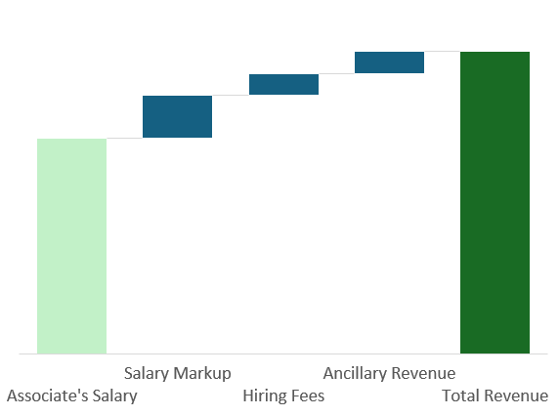
Deconstructing General Staffing Topline
Mode of Headcount Addition | Responsibility | Revenue Stream
Transfers | Payroll, Attendance & Compliance | Salary Markup + Ancillary Revenue
Source & Deploy | Everything in Transfer + Recruitment & Backfilling | May earn hiring fees as well
Net Revenue/PAPM
Notes:
Quess gives data for transfers- 70% headcount addition through transfers. Teamlease said 65-70% in a call.
For some sectors like FMCG, Retail etc Transfers are more prominent while in manufacturing, sourcing model is more prominent
Define PAPM
Salary markup 300-500; Hiring 1000-2500; Ancillary Revenue – Insurance, Small KPIs like dresscode, Mobility of workers from one state to another and their stay, certification and upskilling in case of freshers etc.

Slide 15
General Staffing: Declining Trend in PAPM
Source: TeamLease Quarterly Concalls, PPFAS Research
Notes:
Quess PAPM of 680-700 between FY23 and FY25. However, in Q1, they said the PAPM will be in the range of 600-650

Slide 16
Core Employee Productivity Improvement Plateauing
Source: Company Filings, Concalls, PPFAS Research
Notes:
Higher the associate to core ratio, better the productivity. However, if companies have higher share from manufacturing, productivity decreases.

Slide 17
General Staffing: EBITDA Margins & EBITDA PAPM
Source: Company Filings, Concalls, PPFAS Research
Notes:
Quess went through demerger and so historical data is not available for the same.

Slide 18
General Staffing: Low Capital Intensity
Source: Company Filings, Concalls, PPFAS Research
Notes:
Two models – Collect & Pay and Pay & collect. Collect and Pay is negative working capital model.
Rest of the revenue can have 30-60 days of working capital involved. In effect, working capital on total revenue comes to 12 days or lower under normal circumstances.

Slide 19
High Incremental RoIC
Revenue/Associate/Annum | 3,00,000
EBITDA/Associate/Annum (Considering EBITDA PAPM @283) | 3,400
Depreciation | 0
Tax | 0
NOPAT | 3,400
Working Capital (@12 Days Sales Outstanding) | 10,000
RoIC | 34%
Notes:
Considering there is incremental employee addition, tax rate will be negligible under section 80JJAA

Slide 20
General Staffing – Summary
Pricing pressure leading to reduced net revenue PAPM
Productivity improvements plateauing
EBITDA PAPM trending down
Negligible tax implication due to 80JJAA benefits
Incremental RoIC continues to be high
Foreign expansion can add meaningfully to PAPM & profitability

Slide 21
Professional Staffing (IT Staffing)

Slide 22
Professional Staffing – Difference vsGeneral Staffing
Caters to demand of IT, ITES, GCC and IT employees in Non-IT Companies
Rate Card Model
100% sourcing done by staffing firm
Niche skills need experienced recruiters
High gross margins
Higher working capital intensity – DSO at 60-90
No tax benefit under Section 80JJAA

Slide 23
Professional Staffing – Revenue Growth
 | Quess Corp | Teamlease
3 Year CAGR | 3.1% | 3.7%
Source: Company Presentation and Annual Reports, PPFAS Research
Notes:
Teamlease – 5 Year at 7.6%
Size – 5.97 lakh headcount in 2024.
https://www.theweek.in/news/biz-tech/2024/11/14/indian-it-flexi-staffing-market-likely-to-top-dollar56-billion-by-2025-26-with-a-workforce-of-663-lakh.html?utm_source=chatgpt.com

Slide 24
Macro Challenges: IT Slowdown & Reduced Subcontracting
Source: Company Filings, Concalls, PPFAS Research

Slide 25
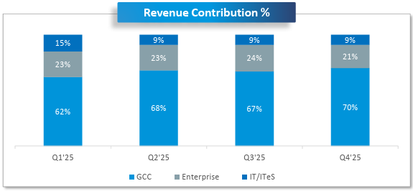
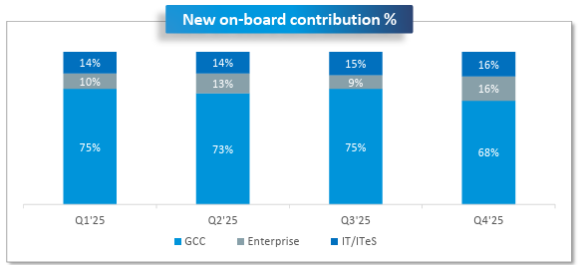
IT Contraction, GCC Expansion
Teamlease:
FY23 – IT Services clients reduced their hiring by 60% during the year
FY24 – “Contract staffing works as a shock absorber in downtimes and we have lost 50% of associate headcount on IT services side”
FY25 – IT sector continues to witness cautious & selective hiring and expect slowdown to continue in H1FY26 as well
Quess Corp:
FY23 – IT services headcount decreased due to tepid market conditions.
FY24 – Hiring continues to remain soft. Permanent Recruitment down by 70% in one of the quarters
FY25 – Continue to see subdued demand & muted forecast from large IT clients
Source: Company Filings, Concalls, PPFAS Research
Notes:
# GCC Clients – Quess – 157, Teamlease – 75; Teamlease – 46% headcount and 64% revenue from GCC

Slide 26

The GCC Opportunity
There are ~1800 Global Capability Centers (GCC) in India and growing
Penetration of flexi staffing in GCC at 8.2% vs 5.5% in IT Staffing
GCCs tend to have higher associate salaries and better margins
Opportunity to expand revenue pool by providing additional services –
  Permanent Recruitment
  RPO
  Set-up Service
  GCC-as-a-Service
Both staffing players and IT companies targeting GCC-as-a-Service opportunity

Slide 27
Professional Staffing: EBITDA Analysis
Source: Company Filings, PPFAS Research
Notes:
Incremental RoIC can be in 15-30% range but not as high as General Staffing because of high working capital and no tax benefit in IT Staffing.

Slide 28
Incremental RoIC Calculation
Revenue/Associate/Annum | 10,00,000
EBITDA/Associate/Annum (Considering EBITDA Margin of 7%) | 70,000
Depreciation | 0
Tax (@25%) | 17,500
NOPAT | 52,500
Working Capital (@90 Days Sales Outstanding) | 2,50,000
RoIC | 21%

Slide 29
Professional Staffing - Summary
Bench strength of recruiters is a key
GCC driving growth over past 3 years
IT demand revival will provide additional boost
Higher margin but lower RoIC vs general staffing

Slide 30
Quess Vs TeamLease: General Staffing
 | Quess Corp | TeamLease
 |  | General Staffing | Degree Apprenticeship
Key Sectors/Segments | Retail – 23%; BFSI – 22%; Manufacturing – 17% | BFSI – 22%; Consumer & Retail – 20%; Manufacturing – 12% | Automotive & Industrials; BFSI; Technology; Consumer, Retail & E-com
Headcount | 447k | 292k | 47k
PAPM | ~680 | ~670 | 300 / 700-800
Revenue Contribution (FY25) | 87% | 93%
EBITDA Contribution (FY25)¹ | 59% | 68%
EBITDA Margin Range (FY25) | 1.5% | 1.07%
Working Capital | 79% - Funded; 21% - upto 60 Days | 86% - Funded; 14% - upto 60 Days
1. EBITDA contribution is before considering corporate overheads Source: Company Filings, PPFAS Research

Slide 31
Quess Vs TeamLease: Professional Staffing
 | Quess Corp | TeamLease
Key Sectors/Segments | GCC – 73% (revenue); Rest from IT Services & IT Staff to non-tech companies | GCC – 64% (revenue) & 46% (headcount); Rest from IT Services & IT Staff to non-tech companies
Headcount | 6.65k | 6.6k
PAPM | >9000 | >5000
Revenue Contribution (FY25) | 6% | 5.3%
EBITDA Contribution (FY25)¹ | 23% | 27%
EBITDA Margin Range (FY25) | 9.3% | 7.3%
Working Capital | 60-90 Days | 60-90 Days
1. EBITDA contribution is before considering corporate overheads Source: Company Filings, PPFAS Research

Slide 32
Global Peer Comparison - Growth
Source: Company Filings, Tikr, PPFAS Research

Slide 33
Global Peer Comparison – EBITDA Margin
Source: Company Filings, Tikr, PPFAS Research

Slide 34
Global Peers: RoE
Source: Company Filings, Tikr, PPFAS Research

Slide 35
Global Peers: RoIC
Source: Company Filings, Tikr, PPFAS Research

Slide 36
Global Peers: Valuation (1/2)
Source: Company Filings, Tikr, PPFAS Research

Slide 37
Global Peers: Valuation (2/2)
Source: Company Filings, Tikr, PPFAS Research

Slide 38
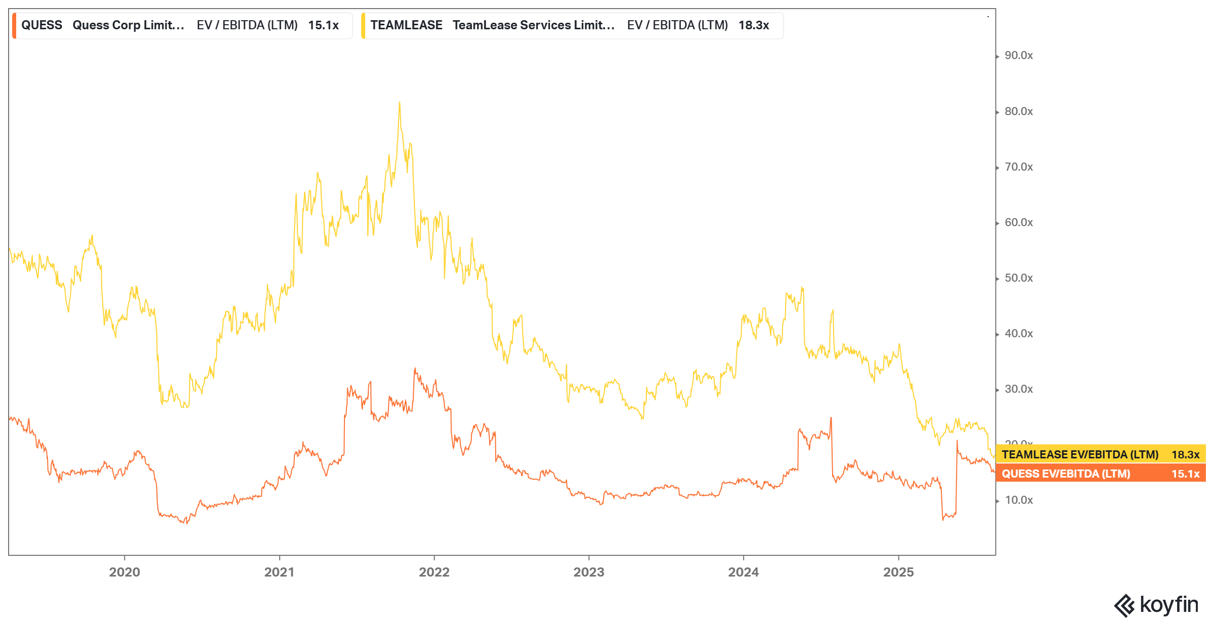
Quess vs Teamlease: Historical Valuation
Source: Koyfin

Slide 39
Conclusion
High long term growth potential
High incremental returns
Reasonable valuations
IT sector demand revival can be a trigger
Very high exposure to the vagaries of economy
Regulatory changes in client industry can impact business
No pricing power → Compressing profitability
Sector’s track record of poor acquisitions

Slide 40
Thank You

Slide 41
Appendix

Slide 42
Quess - Profile
 | General Staffing | Professional Staffing | Overseas Business | Digital Platform
Key Sectors/Segments | Retail – 23%; BFSI – 22%; Manufacturing – 17% | GCC – 73% (revenue); Rest from IT Services & IT Staff to non-tech companies | Singapore – 64%; Middle East – 19% IT-57% | Taskmo; Billion Careers (Hamara Jobs)
Headcount | 447k | 6.65k | 5.6k | NA
PAPM | ~680 | >9000 |  | NA
Revenue Contribution (FY25) | 87% | 6% | 8% | 0%
EBITDA Contribution (FY25)¹ | 59% | 23% | 19% | -1%
EBITDA Margin Range (FY25) | 1.5% | 9.3% | 5.5% | -
Working Capital | 79% - Funded; 21% - upto 60 Days | 60-90 Days
1. EBITDA contribution is before considering corporate overheads Source: Company Filings, PPFAS Research

Slide 43
Teamlease - Profile
 | General Staffing | Degree Apprenticeship | Professional Staffing | Other HR Services
Key Sectors/Segments | BFSI – 22%; Consumer & Retail – 20%; Manufacturing – 12% | Automotive & Industrials; BFSI; Technology; Consumer, Retail & E-com | GCC – 64% (revenue) & 46% (headcount); Rest from IT Services & IT Staff to non-tech companies | Ed Tech - Universities HR Tech Reg Tech Hire Tech
Headcount | 292k | 47k | 6.6k | NA
PAPM | ~670 | 300 / 700-800 | >5000 | NA
Revenue Contribution (FY25) | 93% |  | 5.3% | 1.7%
EBITDA Contribution (FY25)¹ | 68% |  | 27% | 5%
EBITDA Margin Range (FY25) | 1.07% |  | 7.31% | 4.39%
Working Capital | 86% - Funded; 14% - upto 60 Days |  | 60-90 Days | 60-90 Days
1. EBITDA contribution is before considering corporate overheads Source: Company Filings, PPFAS Research
Notes:
In GS, 25% of the BFSI exposure is from NBFCs including 5% from MFIs
5 year range of Rev contributin – GS

